Slide 1


Image Reconstruction
Super-resolution
School of Telecommunication and Information Engineering
Jian Xu

Slide 2
目录
Problem Formulation
The Dictionary
Numerical Considerations
Experiment Details and Results
Summary

Slide 3

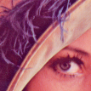
背景及意义
Reconstruct an high-resolution image according to one or a group of low-resolution images.
Low-resolution Image
High-resolution Image

Slide 4

多选题
1分
Which of the following are super-resolution?
Reconstruct HR image from an LR image
Reconstruct HR image from a noisy image
Reconstruct HR image from a blurring image
Reconstruct HR image from several LR images
提交

Slide 5
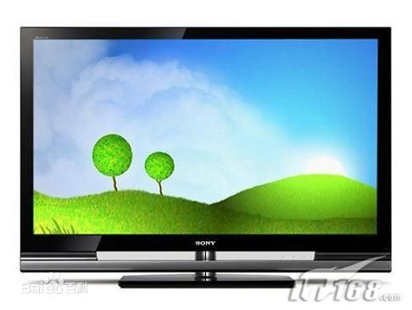
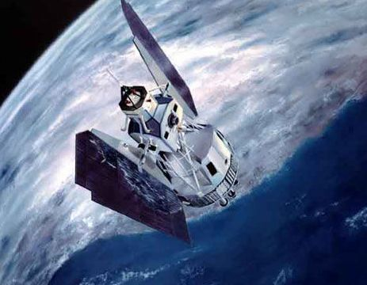
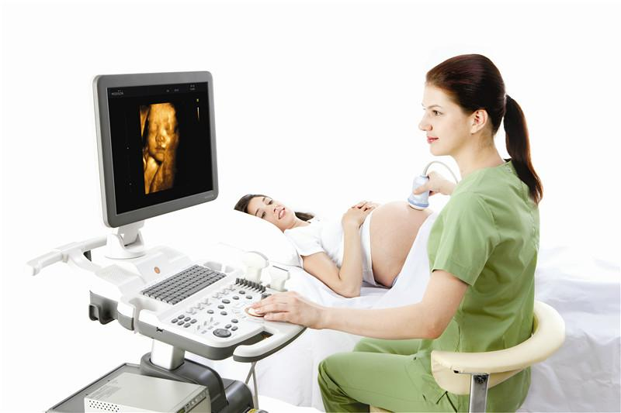
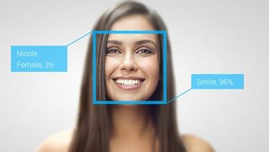
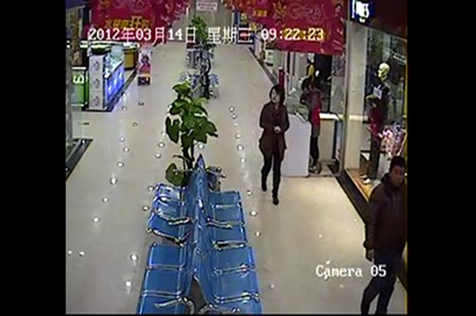
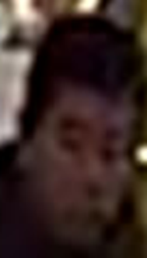
Application
HDTV
Remote Sensing
Medical Diagnose
Face recognition
Crime scene investigation

Slide 6
多选题
1分
Why we use SR method in real application?
medical diagnosis
Face recognition
Crime scene investigation
Remote sensing
提交

Slide 7
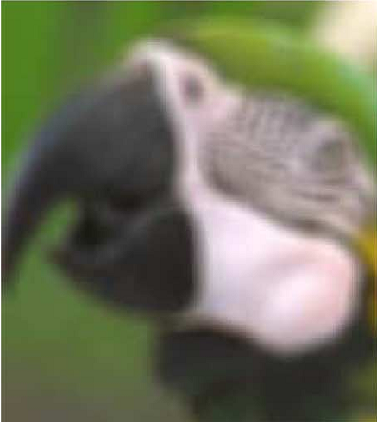
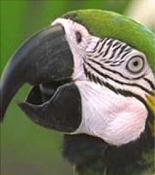
Main idea
The relationship
Degrade image
Clear image

Slide 8
Object of Super Resolution
Effect
Reconstruct sharp edges, more texture, less artifacts.
Efficient
Less computational complex
Less storage space
Low equipment requirements
Adapt to different images and factors

Slide 9
多选题
1分
What is good effect in SR?
Clear edges
Less jaggy artifacts
Less block artifacts
Less details
提交

Slide 10
多选题
1分
What is good efficient in SR?
Low time complexity
Low storage space
Low reading data set frequency
Low requirement of high level equipments
提交

Slide 11
Method
Methods
Interpolation
Reconstruction
Learning

Slide 12
Method
图像超分辨率
方法
插值
重建
学习

Slide 13
多选题
1分
Which of the following method can achieve SR?
Interpolation
Reconstruction
Machine learning
None of the above
提交

Slide 14
Interpolation
To see the details, we need to increase the number of pixels
Question: How to calculate the pixel values?

Slide 15
单选题
1分
What is the key problem in interpolation?
Decide pixel postions
Calculate pixel colors
Calculate pixel values
提交

Slide 16


Based on Reconstruction
Reconstruction needs to model the process of degradation and reconstruction
Degradation
Clear image
Reconstruction
Degradation image
Question：How to know and

Slide 17
多选题
1分
What is the key problems in reconstruction?
Estimate the degradation model
Estimate the color
Estimate the reconstruction model
Estimate the shape of some object
提交

Slide 18


Based on machine learning
Learn the relationship between clear image and blurring image
Clear image
Learning
Degradation image
Question：Who learn
What to learn

Slide 19
多选题
1分
What is the key problems in machine learning?
The equipements
The machine learning model
The training data
The learning time
提交

Slide 20
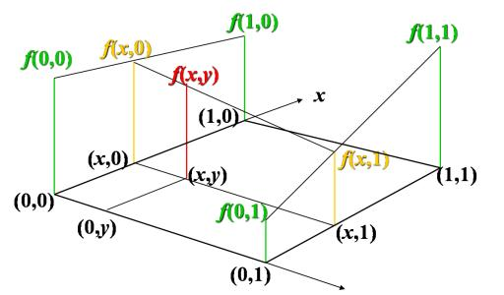
Bilinear
Similar Triangle：

Slide 21
单选题
1分
What function is utilized to calculate the pixel values in bilinear interpolation?
Log function
Exponential function
Linear function
Nonlinear function
提交

Slide 22
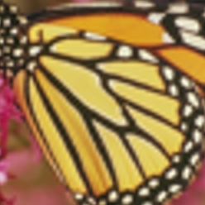

Bicubic Interpolation
-1 | 0 |  | 1 | 2
4 functions and 4 unknown variables

Slide 23
单选题
1分
What function is utilized to calculate the pixel values in bicubic interpolation?
Linear function
Log function
Cubic function
Exponential function
提交

Slide 24
Neighbor Embedding
Collect
Coupled images
Train
Find similar
patches
=5╳
+3╳
+2╳
+0.5╳
+0.8╳
Test
5
╳
3
╳
2
╳
0.5
╳
0.8
╳
+
+
+
+
Reconstruct HR image

Slide 25
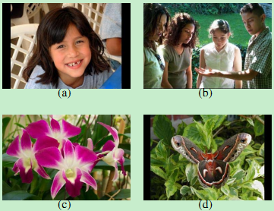
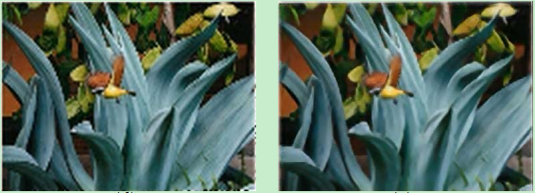
NE Result
分别用(c)和(d)超分得到的图像

Slide 26
单选题
1分
When we get the representation coefficient on low-resolution space, how can we get corresponding high-resolution patch in NE?
Add the representation coefficient on correct high-resolution training patches.
Multiply the representation coefficient on correct high-resolution training patches.
Choose the representation coefficient on correct high-resolution training patches.
None of the above.
提交

Slide 27
Model based on sparse representation
Difficulty：How to train dictionary？

Slide 28
多选题
1分
What is the variables in dictionary training model for SR
Low resolution dictionary
Sparsity
High resolution dictionary
Sparse representation coefficients
提交

Slide 29
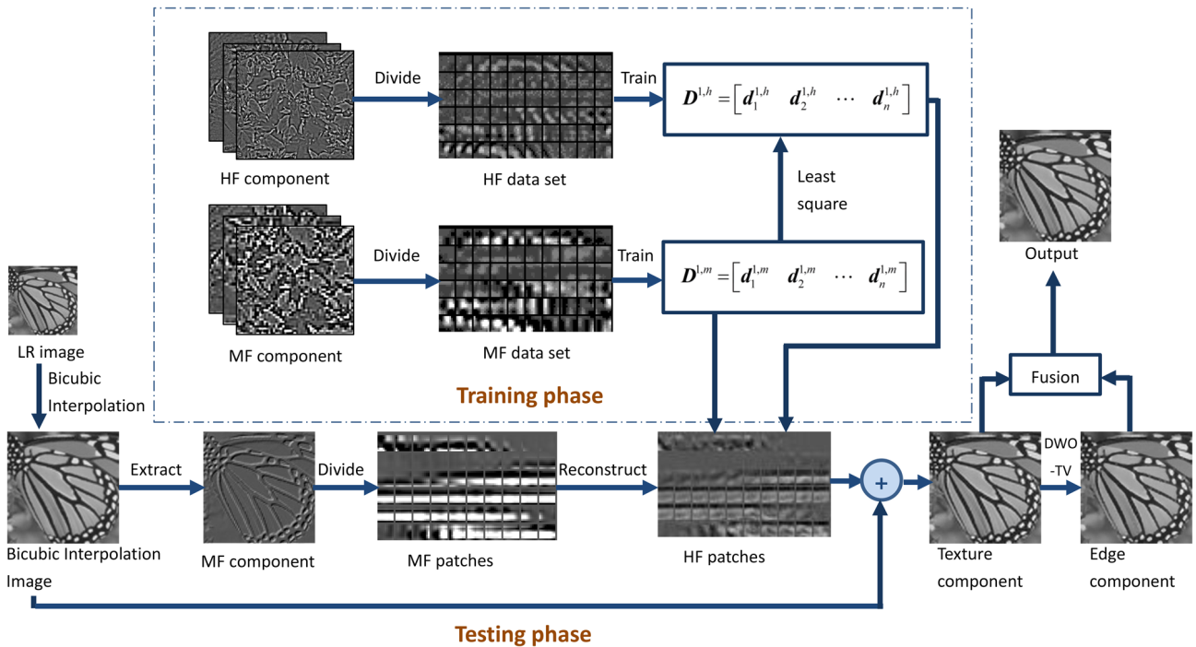
Connect learning and reconstruction

Slide 30
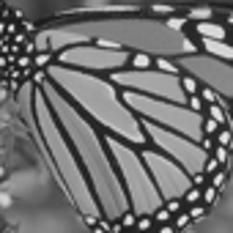
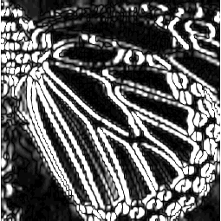
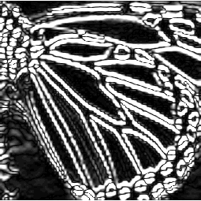
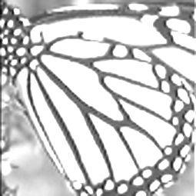
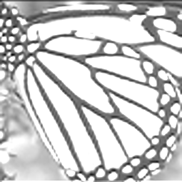
Traditional Feature extration
Change vector
Change vector
Change vector
Change vector
Gradient

Slide 31
多选题
1分
What is used for feature extraction in traditional method?
Gradient
Illumination
PCA features
Average values
提交

Slide 32
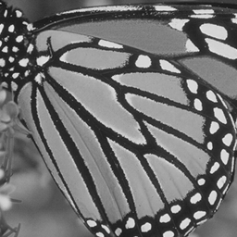
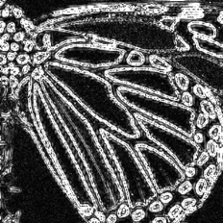
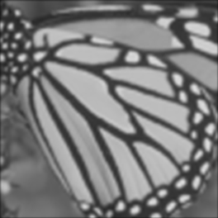
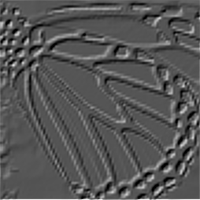

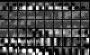
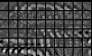
提出的中频特征提取方法
=
+
Bicubic interpolation
HR image
Bicubic Interpolation
High frequency
Gaussian filter
Low frequency component
Mid-frequency component
Low frequency
component
Mid-frequency component
Different component of image
Mid-frequency component
Mid-frequency dictionary
High-frequency dictionary
Mid-frequency training set
Same sparse representation
High-frequency training set
Main idea of method based on training

Slide 33
多选题
1分
One high resolution image contains 3 frequency bands, they are
Blurring frequency
Low frequency
High frequency
Mid frequency
提交

Slide 34
单选题
1分
What is the main task of machine learning based SR?
Find the relationship between different regions of images
Find the relationship between the HR and LR images
Find clear regions in images
Find object in images
提交

Slide 35
SR based on sparse representation
Yang’s method：
K-SVD
HR
dic
LR
dic
Coupled K-SVD：
HF
Coeff
LF
Coeff

Slide 36
多选题
1分
What are the strategies in training the following model?
Connect the two dictionaries
Separate the dictionaries
Train the two dictionaries iteratively
Delete the dictionaries
提交

Slide 37




SR based on sparse representation
Zeyde：
（a）SRSC
（b）Zeyde 的方法

Slide 38
Anchor based sparse representation
How to find a project matrix to transform LR to HR image?

Slide 39
单选题
1分
Which of the following equation is used to calculate the HR image?
提交

Slide 40
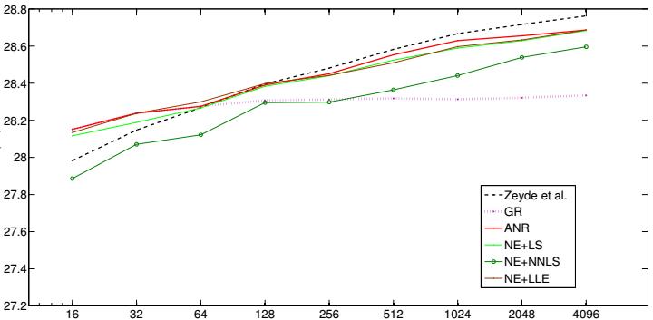
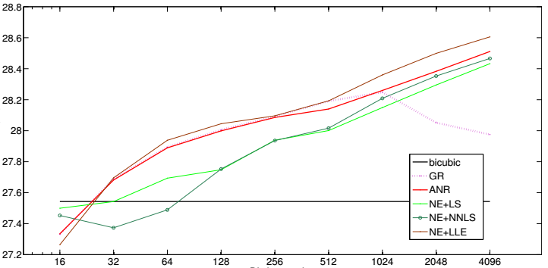
PSNR
Dictionary size-PSNR
(Training dictionary)
Dictionary size-PSNR
(Random dictionary)

Slide 41
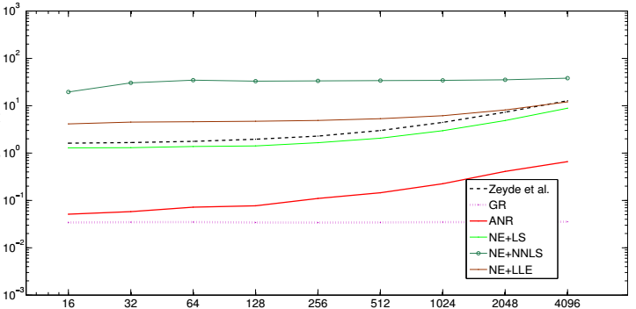
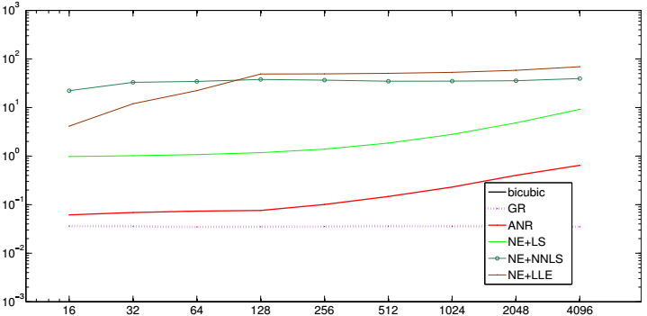
Dictionary size-Time
(Training dictionary)
Dictionary size-Time
(Random dictionary)

Slide 42
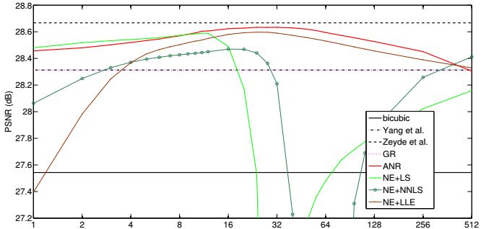
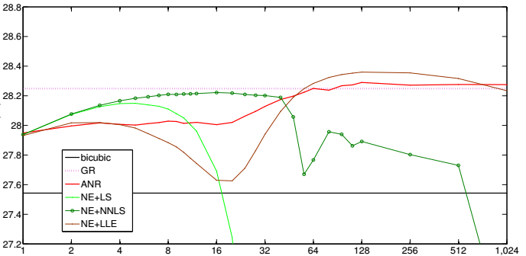
Neighborhood size-PSNR
(Training dictionary)
Neighborhood size-PSNR
(Random dictionary)

Slide 43
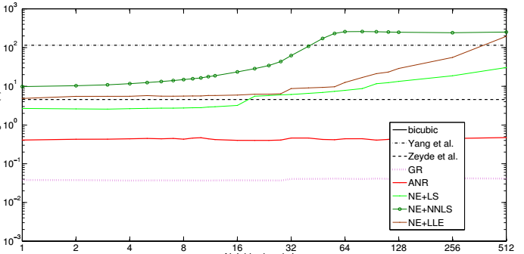
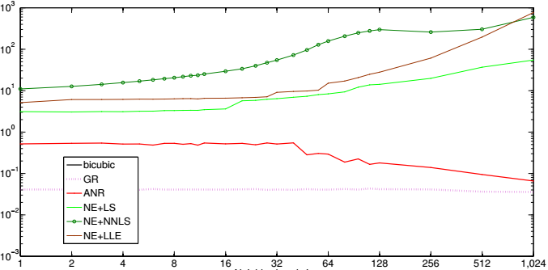
Neighborhood size-Time
(Training dictionary)
Neighborhood size-Time
(Training dictionary)

Slide 44
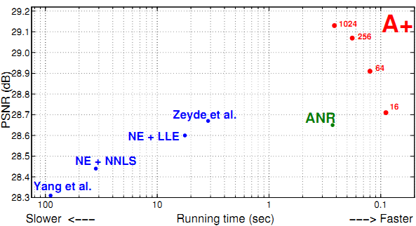

Slide 45
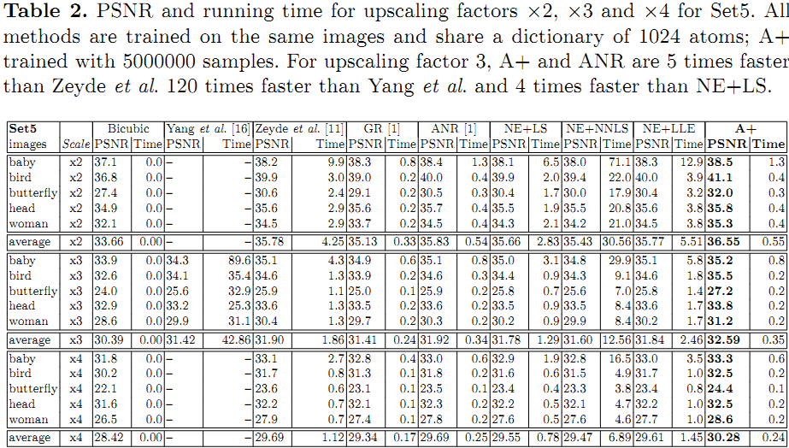

Slide 46
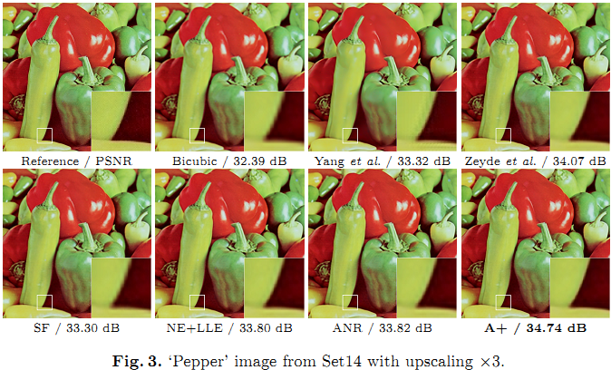

Slide 47
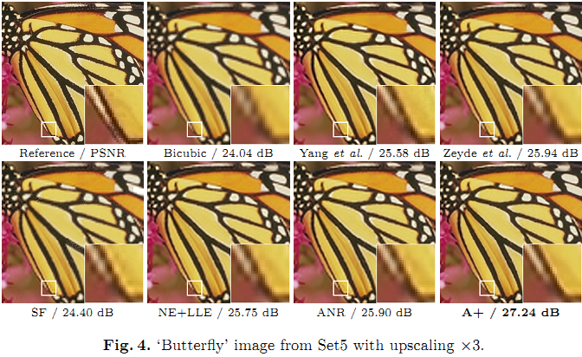

Slide 48

Prior——Smooth
Most of the image parts are smooth.

Slide 49
多选题
1分
Which of the following is correct?
Most of the image is smooth
Most images contain texture
Images are all smooth
Images are all cartoons
提交

Slide 50
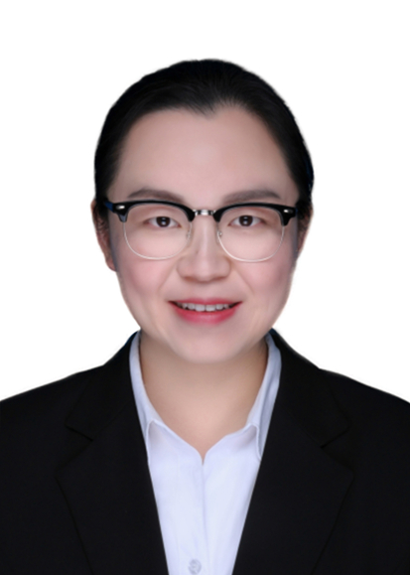
Prior——External repetition

Slide 51
单选题
1分
What is external repetition?
Images are similar
Image colors are similar
Small image patches in different images are similar
Images are not similar
提交

Slide 52
Prior——Local similarity

Slide 53
单选题
1分
What is local similarity?
Image patches are not similar
Image patches are similar with far away patches
Image patches are similar with their neighbor patches
Similar patches are local
提交

Slide 54
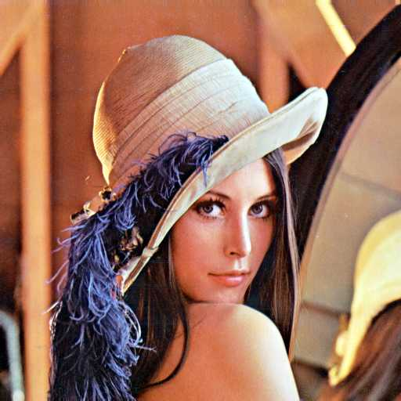
Prior——Non local similarity

Slide 55
单选题
1分
What is non-local similarity?
此题未设置答案，请点击右侧设置按钮
此处添加选项内容
此处添加选项内容
此处添加选项内容
此处添加选项内容
提交

Slide 56
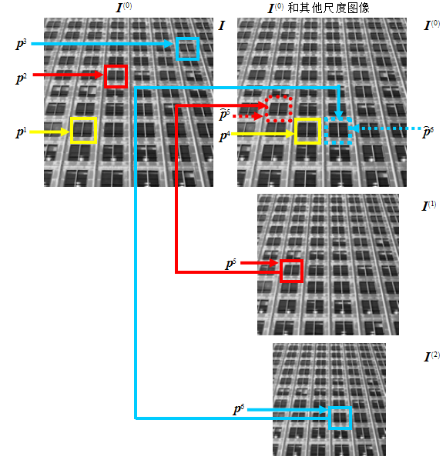
Prior——Pyramid self-similarity

Slide 57
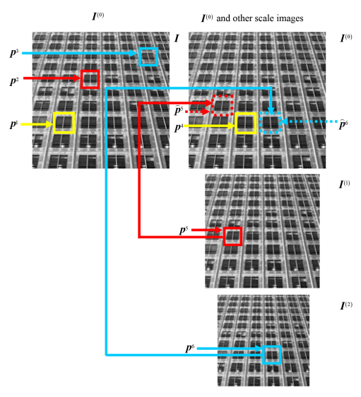
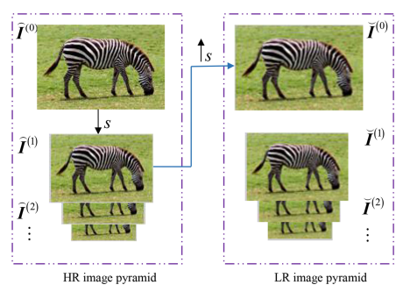
Self-learning

Slide 58
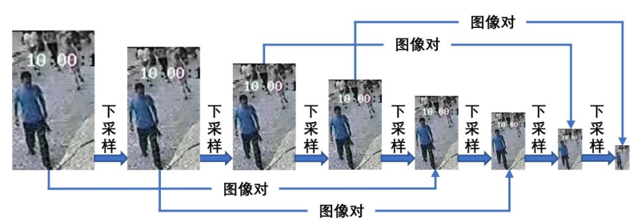
Self-learning

Slide 59
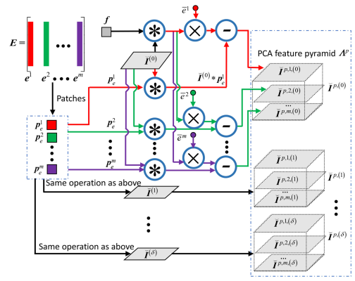
Convolutional PCA

Slide 60
Neighbor Embedding
Collect
Coupled images
Train
Find similar
patches
=5╳
+3╳
+2╳
+0.5╳
+0.8╳
Test
5
╳
3
╳
2
╳
0.5
╳
0.8
╳
+
+
+
+
Reconstruct HR image

Slide 61
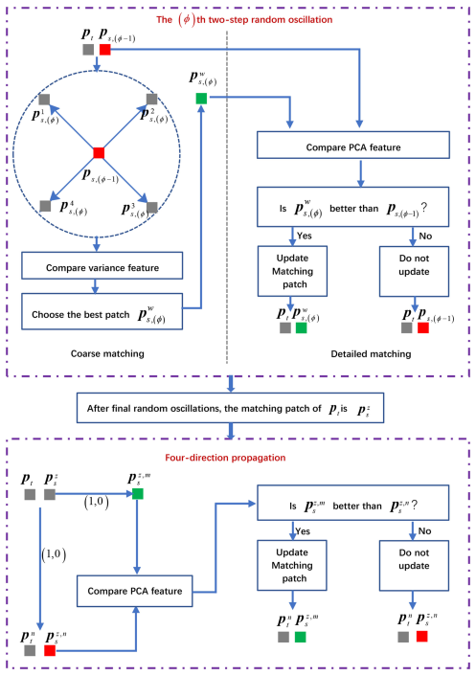
Random Oscillation

Slide 62
Four direction Propagation

Slide 63
合成HR图像块
1
2
3
4

Slide 64
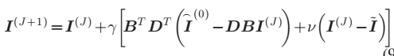
Iterative back-projection
LR image
-
Different map (LR)
Different map (HR)
Down sampled image(LR)
reconstructed image
+
Update reconstructed image

Slide 65
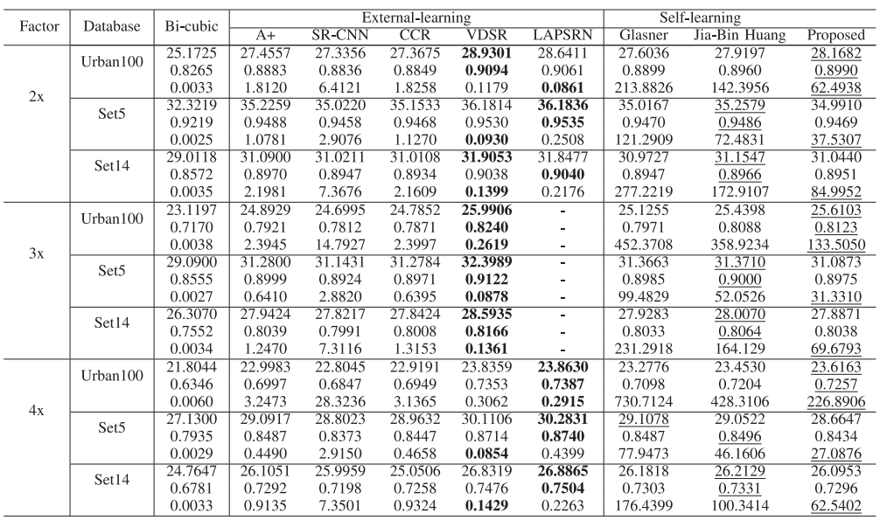
Results

Slide 66
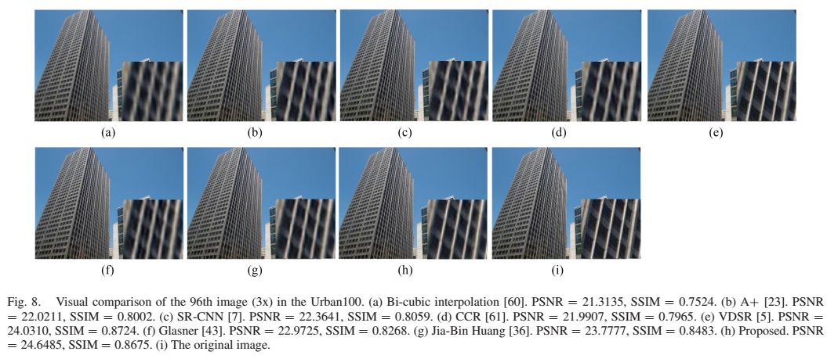
Results

Slide 67
Deep learning
Differences between traditional and CNN
LR training images
Unify feature space
HR training image
Work on image patches
Transform to unify feature space
Neural Network
LR image
HR image

Slide 68
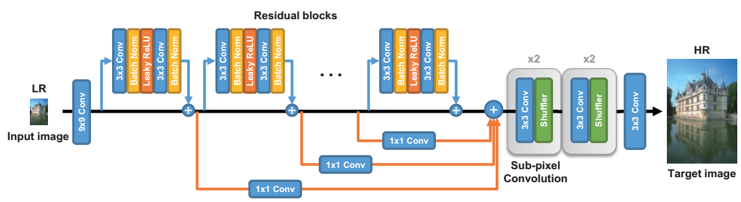
Deep learning
Your task is to know the content of the flow chart.
You should know every block, every operation, every symbol.

Slide 69
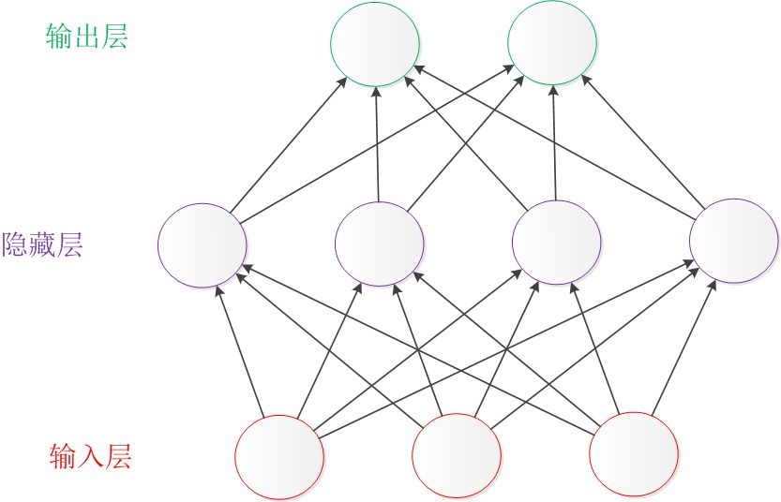


Neural Network
三层神经网络：
神经网络的基本模型：

Slide 70

Activation Function
ReLU
Leaky ReLU

Slide 71

Convolution
Conv: 卷积

Slide 72

Meaning of operations
nn = Conv2d(n, 4, (3, 3), (1, 1), act=None, padding=‘VALID', W_init=w_init,b_init=b_init, name='n64s1/c1/%s' % i)

Slide 73

Group convolution
Input dimension:
Kernel dimension:
Kernel Number:

Slide 74

Depthwise Convolution
当分组数量等于输入map数量，输出map数量也等于输入map数量

Slide 75

Global Depthwise Convolution
卷积核的尺寸与输入map的尺寸相同

Slide 76

Channel shuffle
把分组卷积之后的Channels重新分组

Slide 77
Batch Normalization
Batch Normalization：批标准化把所有的分布变成标准分布
为了避免由于第一层参数的改变导致的第二层分布也发生改变
计算均值 计算方差
把x归一化
把它的范围转到合适范围内，相当于恒等变换

Slide 78

Pool
最大值池化

Slide 79
Deconvolution
Up sampling:

Slide 80
Flattern
A layer that reshapes high-dimension input into a vector.

Slide 81
Elementwise
按元素乘积
按元素求和
保存元素大者

Slide 82
stack
[1,2,3]->[[1,2,3]]
[4,5,6]->[[4,5,6]]
[[1,2,3],[4,5,6]]

Slide 83
Reshape Layer

Slide 84
Sign

Slide 85
Expand Dims
扩展一个维度

Slide 86
UpSampling
class tensorlayer.layers.UpSampling2d(scale, method='bilinear', antialias=False, data_format='channel_last', name=None)

Slide 87

SR
[1]. Dong, C., et al. Learning a Deep Convolutional Network for Image Super-Resolution. in European Conference on Computer Vision. 2014. Zurich, Switzerland.

Slide 88

FSRCNN

Slide 89

ZSSR

Slide 90

ZSSR

Slide 91


ZSSR

Slide 92

ZSSR Results

Slide 93

GAN

Slide 94

ESRGAN

Slide 95


ESRGAN

Slide 96

ESRGAN

Slide 97


SRFeat

Slide 98




基础知识——正则化模型
旋转
模糊
下采样
加噪声
：高分辨率图像
：低分辨率图像
：退化矩阵
：正则化约束
：噪声
：拉格朗日乘子
难点：正则化约束怎么设计？

Slide 99
total variation
In image processing is the horizontal gradient, and is the vertical gradient.

Slide 101
Total variation with constraints

Slide 102


Slide 103

Curve lenghth

Slide 104


Curve lenghth

Slide 105

Results

Slide 106


Slide 107

Multilayer

Slide 108

Vertical propagation

Slide 109
Blind SR
Generate different variables of degradation.
Estimate Kernel

Slide 110

Some Results

Slide 111

Some Results

Slide 112


Slide 113


Slide 114


Slide 115
def train_g(self):
# Zeroize gradients
self.optimizer_G.zero_grad()
# Generator forward pass
g_pred = self.G.forward(self.g_input)
# Pass Generators output through Discriminator
d_pred_fake = self.D.forward(g_pred)
# Calculate generator loss, based on discriminator prediction on generator result
loss_g = self.criterionGAN(d_last_layer=d_pred_fake, is_d_input_real=True)
# Sum all losses
total_loss_g = loss_g + self.calc_constraints(g_pred)
# Calculate gradients
total_loss_g.backward()
# Update weights
self.optimizer_G.step()

Slide 116
regularization term
encourages sum to 1
Penalizing non-zero values
close to the boundaries. Is a constant mask of weights
Exponentially growing with distance from the center of
encourages sparsity to prevent the
network from over smoothing kernels.
encourages th center of
mass to be at the center of the kernel, where
denote the center indices.

Slide 117
def train_d(self):
# Zeroize gradients
self.optimizer_D.zero_grad()
# Discriminator forward pass over real example
d_pred_real = self.D.forward(self.d_input)
# Discriminator forward pass over fake example (generated by generator)
# Note that generator result is detached so that gradients are not propagating back through generator
g_output = self.G.forward(self.g_input)
d_pred_fake = self.D.forward((g_output + torch.randn_like(g_output) / 255.).detach())
# Calculate discriminator loss
loss_d_fake = self.criterionGAN(d_pred_fake, is_d_input_real=False)
loss_d_real = self.criterionGAN(d_pred_real, is_d_input_real=True)
loss_d = (loss_d_fake + loss_d_real) * 0.5

Slide 118
# Calculate gradients, note that gradients are not propagating back through generator
loss_d.backward()
# Update weights, note that only discriminator weights are updated (by definition of the D optimizer)
self.optimizer_D.step()

Slide 119
Kernel
def calc_curr_k(self):
"""given a generator network, the function calculates the kernel it is imitating"""
delta = torch.Tensor([1.]).unsqueeze(0).unsqueeze(-1).unsqueeze(-1).cuda()
for ind, w in enumerate(self.G.parameters()):
curr_k = F.conv2d(delta, w, padding=self.conf.G_kernel_size - 1) if ind == 0 else F.conv2d(curr_k, w)
self.curr_k = curr_k.squeeze().flip([0, 1])

Slide 120
Constraints
def calc_constraints(self, g_pred):
# Calculate K which is equivalent to G
self.calc_curr_k()
# Calculate constraints
self.loss_bicubic = self.bicubic_loss.forward(g_input=self.g_input, g_output=g_pred)
loss_boundaries = self.boundaries_loss.forward(kernel=self.curr_k)
loss_sum2one = self.sum2one_loss.forward(kernel=self.curr_k)
loss_centralized = self.centralized_loss.forward(kernel=self.curr_k)

Slide 121
loss_sparse = self.sparse_loss.forward(kernel=self.curr_k)
# Apply constraints co-efficients
return self.loss_bicubic * self.lambda_bicubic + loss_sum2one * self.lambda_sum2one + \
loss_boundaries * self.lambda_boundaries + loss_centralized * self.lambda_centralized + \
loss_sparse * self.lambda_sparse

Slide 122
主函数
def train(self, g_input, d_input):
self.set_input(g_input, d_input)
self.train_g()
self.train_d()

Slide 123
主函数
def train(conf):
gan = KernelGAN(conf)
learner = Learner()
data = DataGenerator(conf, gan)
for iteration in tqdm.tqdm(range(conf.max_iters), ncols=60):
[g_in, d_in] = data.__getitem__(iteration)
gan.train(g_in, d_in)
learner.update(iteration, gan)
gan.finish()

